Slide 1

A VISION FOR
CLIMATE HOPE
Catalyzing Change
through Person-to-Person Movement Building
Notes:
Greetings! I am ________. I am excited to share with you today about the UCC’s Vote for Climate Hope Campaign.

Slide 2
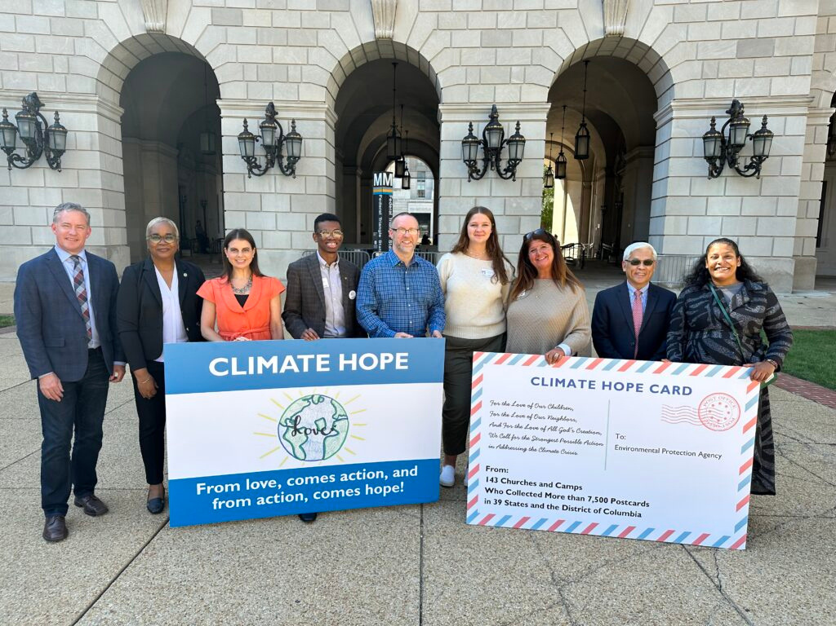
Notes:
Before I tell you about the vision for this year’s campaign, I want to begin by telling you the story that led to this picture. It is the story of the UCC’s first Climate Hope Campaign. It took place last year.
Through the 2023 Climate Hope Cards campaign, churches across the country collected over 8,000 postcards that were delivered in-person to the Environmental Protection Agency headquarters in Washington, D.C. This campaign aimed to save thousands of lives, address societal inequities, and get our nation on track to meet the climate goal of a carbon free electrical grid by 2035. We joined with other organizations to call upon the EPA to strengthen a series of rules and thereby enable this happen.
In this photo, you see 16-year-old Mallory Hope Luca who led our UCC delegation. Mallory was the winner of our art contest for children and youth last year.
I am proud to say that with youth leadership and strong participation from congregations across the country the UCC made an important and unique contribution to a larger coalition effort that was successful!

Slide 3
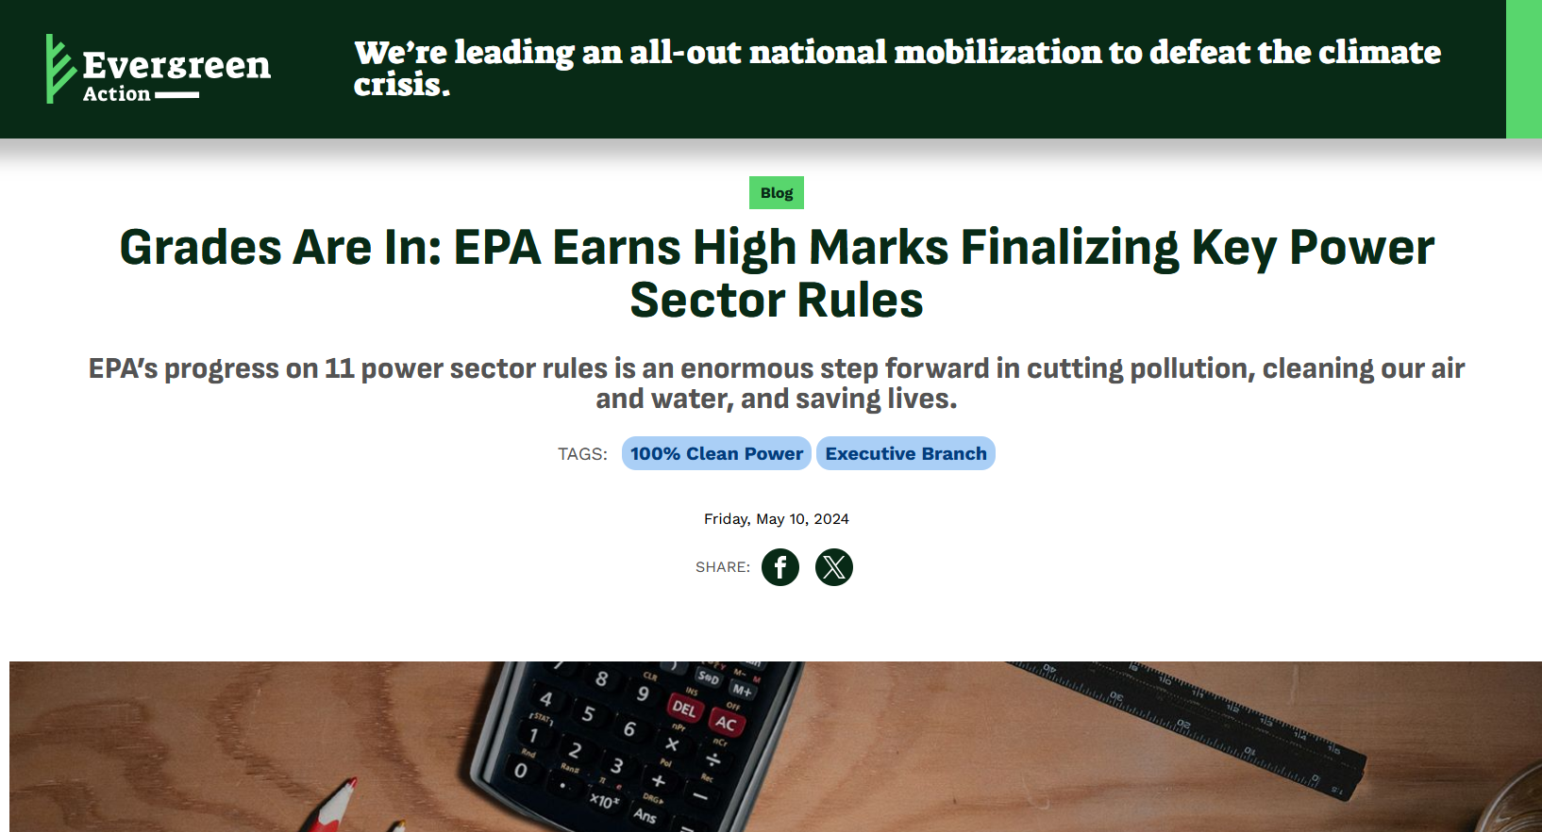
Notes:
The EPA earned high marks for its revision of rules. This campaign was our first lived lesson of Spirit-fueled, people power and what it can accomplish. For us, this was just the beginning…

Slide 4



“Where there is no vision, the people perish.”
—Psalm 29:18
But where there is a vision, the people flourish.
Notes:
All of you have probably heard the famous verse of scripture from Psalm 29, verse 18: “Where there is no vision, the people perish.” Have you ever thought about what it means when there is a vision? When people have a vision, they flourish.
The Climate Hope Campaign has a vision and a strategy for addressing the crisis before us. Let’s explore what this entails.

Slide 5
What do we need for a strong
and compelling vision?
Notes:
What do we need for a strong and compelling vision? What’s going to motivate and drive us to effective action?

Slide 6
For a strong and compelling vision,
we need it to be connected
to a strong and compelling purpose.
Notes:
Like last year, we did an art contest again this year. Who doesn’t love the artwork of children? But we didn’t do this contest simply for the sake of seeing lots of cuteness from five-year-olds and amazing talent from 16-year-olds. We know that the number one reason people of faith get involved to address the climate crisis is because they care about their kids and grandkids. They care about the world their children are inheriting. Moreover, our children and youth have some powerful messages to convey through their art. Let’s take a look at this year’s art from our finalists…

Slide 8
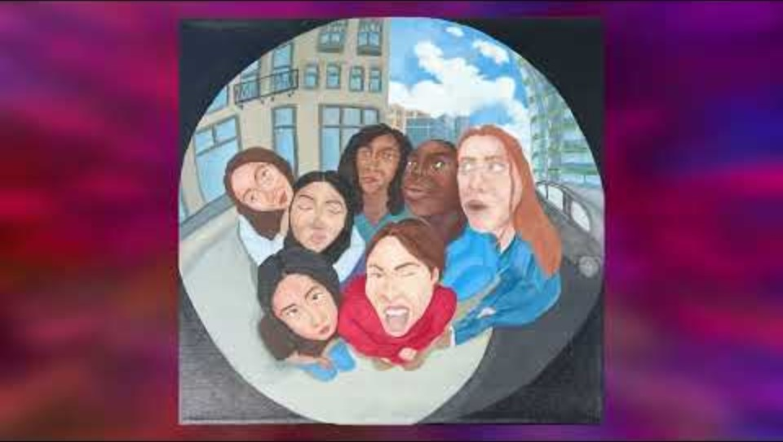
Notes:
As we watch this video of 75 works of art, reflect upon what our children and youth are telling us. What messages are they sending to us? What purpose are they calling upon us to take on?
[Watch video]
After watching this video, what are your reflections? What purpose is driving you?

Slide 9
For a strong and compelling vision,
we need a vehicle that can get us
to our destination.
Notes:
Now, a strong and compelling vision is going to require more than a strong and compelling sense of purpose, we are also going to need a vehicle that can get us to our destination.
A lot of enormous political and economic forces got us to where we are today, and it is going to take a lot of people power to get us to a better place. This people power can be described as a movement. A political scientist at Harvard University named Erica Chenoweth once did a study that found that movements which engage 3.5% of a population have never failed to bring about change. The UCC can’t be 3.5% of the population by itself, but we can be a powerful force as part of a larger movement that gets us there.
One can think of a movement as a large orchestra or band. Our goal is to play the best instrument available to us with all our heart and soul, so that we can contribute in the best possible way to the larger orchestra as we give voice to a beautiful song.

Slide 10
As part of a larger coalition and movement,
our vehicle is a national, faith-rooted campaign for Climate Hope.
Notes:
As part of a larger coalition and movement, our vehicle is a national, faith-rooted campaign for Climate Hope. How did we arrive at this campaign?
In some ways, we arrived at this campaign over many years of UCC General Synod resolutions that have emphasized addressing the climate crisis : (1) as a matter of justice—racial justice, economic justice, global justice, and more; (2) as a matter that ultimately requires our federal government to act; and (3) as a matter of utmost urgency to reduce emissions as fast as we possibly can.
Let’s unpack more of the vision and strategy behind our Climate Hope campaigns…

Slide 11
Why a national campaign?
  We need solutions that match the scale and the urgency of the crisis faced.
  For goals that are national in scope, we need organizing that is national in scope.
  One of our greatest strengths is that our churches have deep roots in communities throughout our country.
Notes:
Why a national campaign?
We need solutions that match the scale and the urgency of the crisis faced.
A metaphor that helps think about this is that of a forest fire. If you saw a forest fire approaching your home, you wouldn’t rush outside to fight it with a watering can and garden hose. Sometimes the only way to confront a crisis is to pick up the phone and call upon those who can act with the speed, scope, and scale necessary. In the case of the climate crisis, that’s our federal government, and we need a national movement to make the needed call to action.
For goals that are national in scope, we need organizing that is national in scope.
As much as ever, we need to come together to realize our power as a force within our society. We are uniquely suited to do this…
One of our greatest strengths is that our churches have deep roots in communities throughout our country.

Slide 12
Why faith-rooted?
  The climate crisis is a spiritual crisis that faith communities are equipped and able to address.
  Faith communities effectively tap into what fundamentally motivates people to act: love.
  Faith communities provide the mutual support and care needed to sustain people in taking action.
Notes:
As faith communities, what do we uniquely offer to the broader movement for climate justice? There are a lot of ways we could answer this, but here are three:
First, the climate crisis is a spiritual crisis that faith communities are equipped and able to address.
Second, faith communities effectively tap into what fundamentally motivates people to act: love.
Third, faith communities provide the mutual support and care needed to sustain people in taking action.
In short, faith communities are in many ways made to meet this moment. We just need the right vision…

Slide 13
For a strong and compelling vision,
we need to see how our power to make a difference can multiply and expand.
Notes:
For a strong and compelling vision, we need to see how our power to make a difference can multiply and expand.

Slide 14
Our strategy is to engage in catalytic person-to-person movement building.
Notes:
Our strategy is to engage in catalytic person-to-person movement building. Today, we talk about videos and social media posts going viral. Often social media can be an echo chamber where like-minded people are talking to like-minded people. To build a movement, one needs more than this. People often join a movement not because they see or hear something on their iPhone, but because someone they know invited them to join. Our goal is to make these person-to-person invitations viral in communities across the country.

Slide 15
Through a virtuous cycle of invitation, we personally invite community members to join a growing movement and in turn invite others to join.
Notes:
Through a virtuous cycle of invitation, we personally invite community members to join a growing movement and for them to in turn invite others to join.
To provide people with a way to do just this, we use cards that serve as a conversation starter and a call to action. Last year, we used cards to collect written comments to deliver to the EPA. This year we surveyed the local church leaders who led last year’s effort, and we learned that along with advocating for policies that address environmental racism, they wanted to elect climate justice champions to office. We can’t pass the policies we want to see unless we have elected officials who are willing to pass them, or at least, elected officials who might be persuaded into supporting such legislation.
Let’s take a look at this year’s Climate Hope Voter Pledge Card…

Slide 16
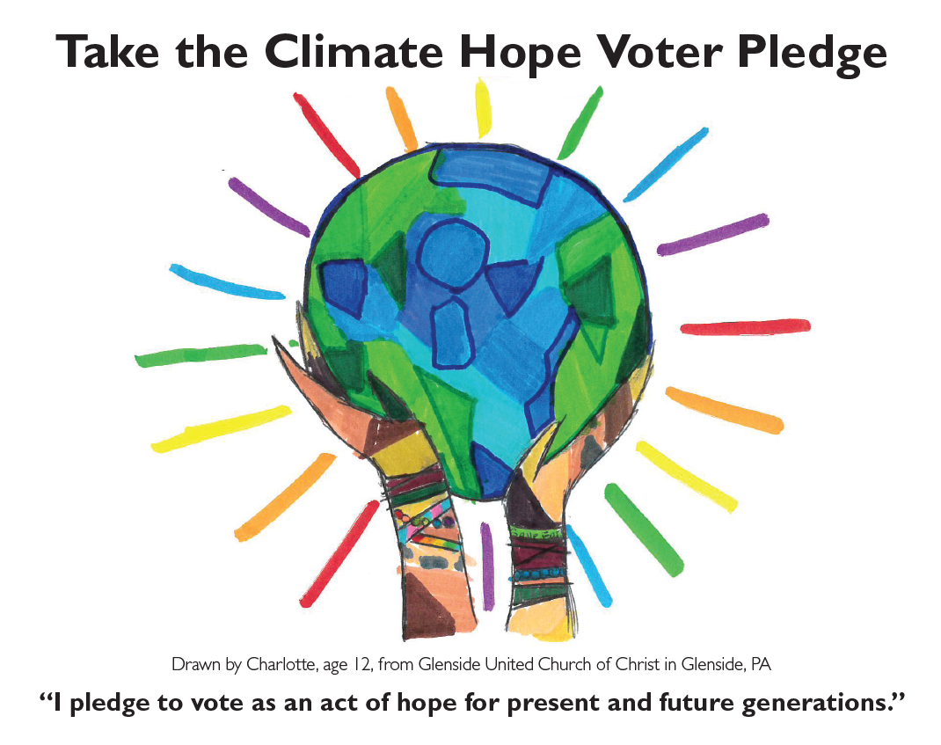
Notes:
On the front, you will see the winning artwork from 12-year-old Charlotte who lives just outside of Philadelphia. To tap into what motivates people to act, you will see it says, “I pledge to vote as an act of hope for present and future generations.”

Slide 17
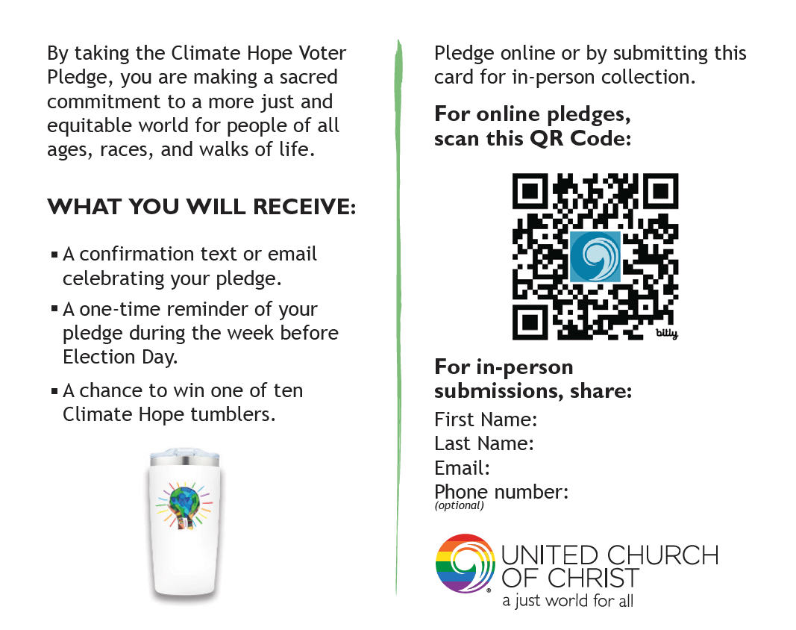
Notes:
On the back of the card, we give an indication of our values. In a sense, voting is a way in which we can act upon our love of neighbor. By voting our values, we are making a sacred commitment to a more just and equitable world for people of all ages, races, and walks of life.
We know from similar campaigns conducted by others that people are more likely to vote (1) if it is connected to a cause they care about, (2) if they make a promise to someone else to vote, and (3) if they get a reminder to vote near the time of the election. We are covering all of these things with the Climate Hope Voter Pledge.
We know people have a fear of email spam, so we promise to only send two emails to those who pledge: a confirmation email and a reminder email near the time of the election.
Those who take the pledge also have a chance to win a Climate Hope Tumbler. The cup you see on this card.

Slide 18
In 2024, our goal is to invite as many people as possible to take the Climate Hope Voter Pledge and ask others to take the pledge as well.
Notes:
In 2024, our goal is to invite as many people as possible to take the Climate Hope Voter Pledge and to become an ambassador themselves by asking their family and friends to take the pledge as well.

Slide 19
Four Opportunities to Join in Catalyzing Hope
#1 Become a Climate Hope Catalyst
Share the pledge with as many people as possible!
Anyone can take the pledge by visiting:
ucc.org/VoteClimateHope
Notes:
There are four ways you can join our effort:
Become a Climate Hope Catalyst
Share the Climate Hope Voter Pledge with as many people as possible. The card has a QR code on it, so you can have an unlimited number of family, friends, and people in the community scan it, and thereby take the pledge on their smart phone.

Slide 20
Four Opportunities to Join in Catalyzing Hope
#2 Become a Climate Hope Team Leader
Gather a team to collect pledges in your community. Order pledge cards if you haven’t already done so: ucc.org/ClimateHopeRegistration
Notes:
#2 Become a Climate Hope Team Leader
Gather members of your church to work together as catalysts in your community.

Slide 21
Four Opportunities to Join in Catalyzing Hope
#3 Become a Climate Hope Regional Organizer
Let us know that you are interested in working with local church leaders in your region: ucc.org/ClimateHopeOrganizer
Notes:
#3 Become a Climate Hope Regional Organizer
Organize churches throughout the state or region to form hope spreading teams. We need people who will continue to organize other churches to take action.

Slide 22
Four Opportunities to Join in Catalyzing Hope
#4 Become a Climate Hope Angel
Make a donation to support Climate Hope: ucc.org/ClimateHopeDonations
Notes:
#4 Become a Climate Hope Angel
Support the UCC’s Climate Hope Campaigns financially. For donations of $100 or more, we will send you a free Climate Hope Mug featuring Charlotte’s artwork.

Slide 23
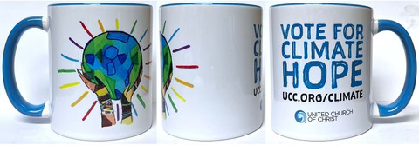
Notes:
#4 Become a Climate Hope Angel
Support the UCC’s Climate Hope Campaigns financially. For donations of $100 or more, we will send you a free Climate Hope Mug featuring Charlotte’s artwork.

Slide 24
"Hope is a verb with its sleeves rolled up."
—David Orr
Notes:
As I close, I want to leave you with a quote from a UCC climate scholar and activist named David Orr. He once said, “Hope is a verb with its sleeves rolled up.”
Together, we can generate hope this fall by taking action and by inviting others to take action with us.

Slide 25
QUESTIONS?
Notes:
I would be glad to hear any questions you might have.

